Slide 1
Marketing Your Law Library with QR Codes
Kathleen M. Dugan, Esq., MLS
Cleveland Law Library
April 27, 2018

Slide 2
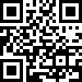
Definition of a QR Code
A QR code or Quick Response Code is a:
Two-dimensional (2D) barcode.
Small square of dots with over 4000 characters.
A QR Code contains encoded or pixelated information.
A QR Code can be read or scanned by using an APP on a SmartPhone called a QR code reader.

Slide 3
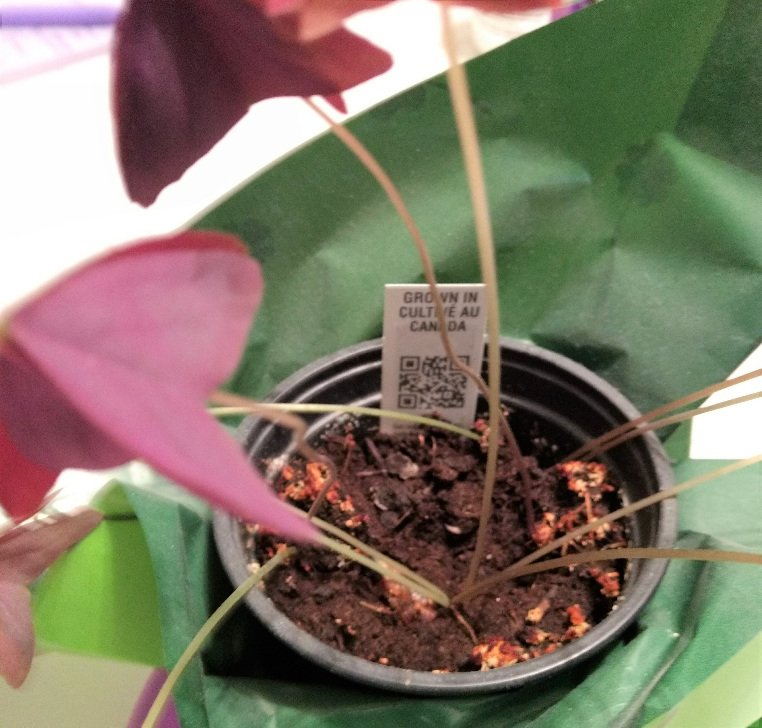
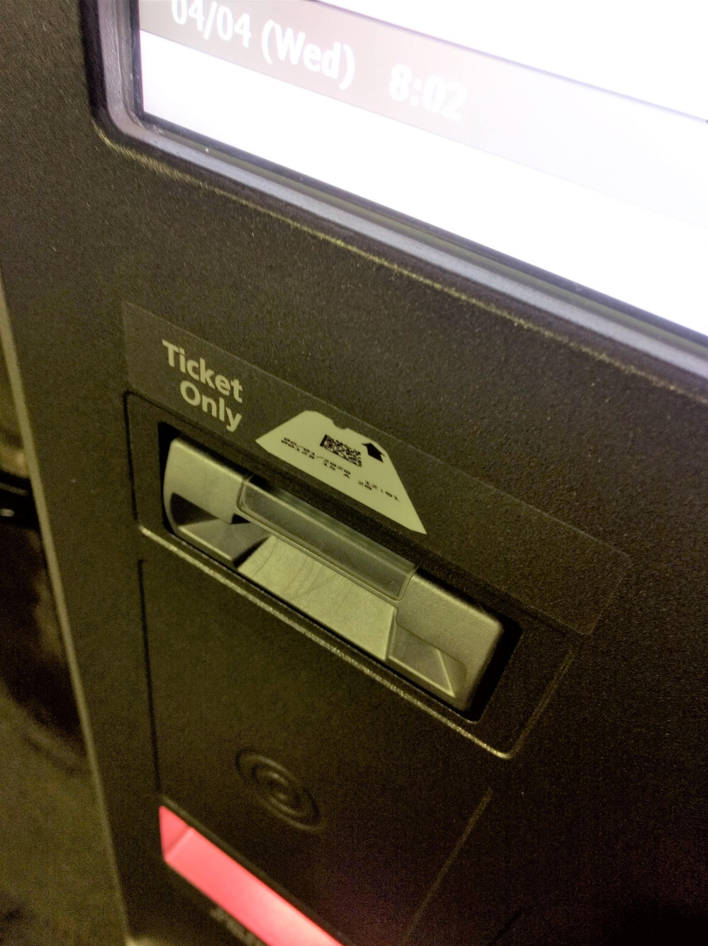
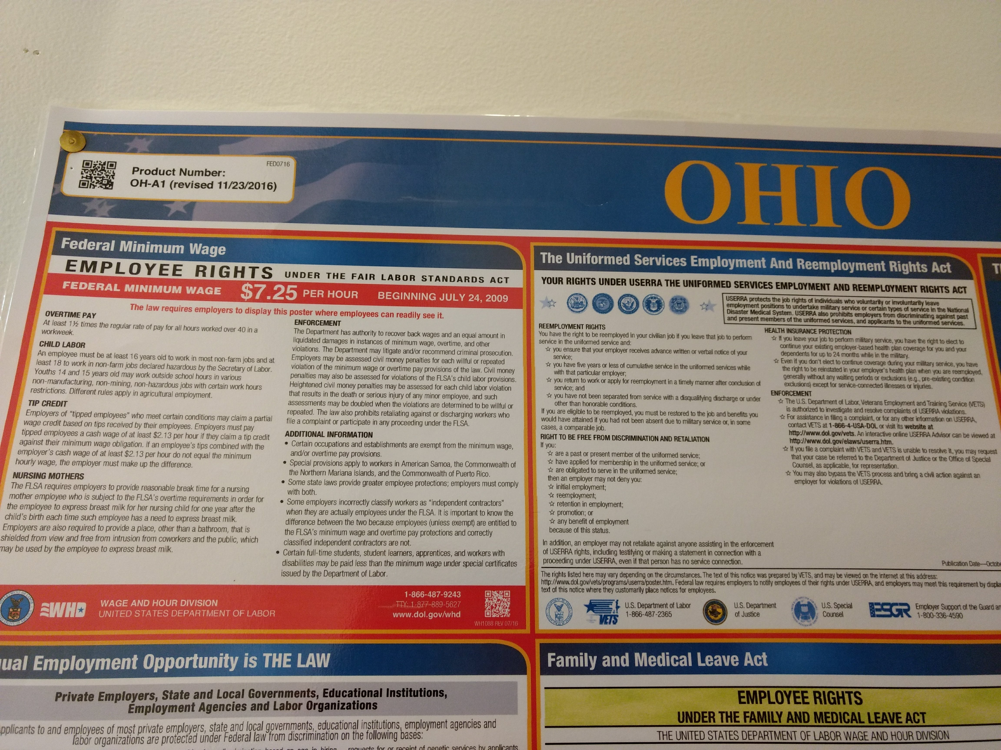
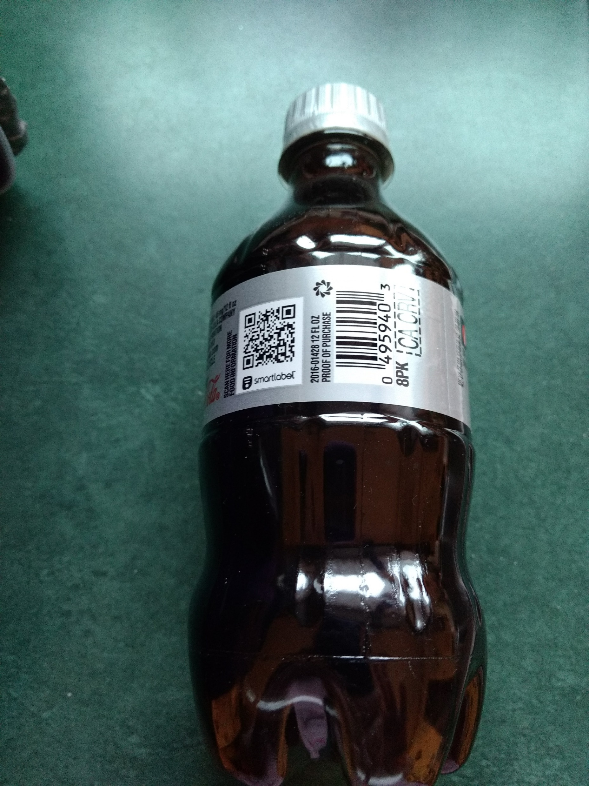
QR Codes are Everywhere
My shamrock plant
Our Employment Poster
Parking garage tickets
My Diet Coke bottle
…

Slide 4
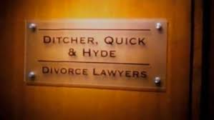
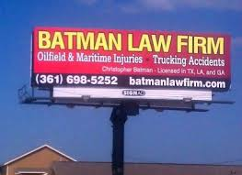
Where Lawyers Are Using QR Codes
Business cards
Letterheads
Free articles, blog content, ebooks
Firm brochures
Emails, news releases
Portfolios of large verdicts they have won
Lists of representative clients
Law firm rankings
Lawyer and/or law firm bios
Presentations, speeches, videos
Specialties
Diversity initiatives

Slide 5
Why Use QR Codes?
QR codes are cutting-edge new marketing tools:
Free and easy way to connect with patrons and potential patrons
Demonstrate that your law library embraces emerging technologies
Particularly appeal to millennials and those in newer Gen Z and Gen Alpha generations who were born as digital natives

Slide 6
How Law Libraries Can Use QR Codes
Incorporate into Print:
Flyers
Signage
Business Cards
Labels on book stacks/ranges
Embed Online in:
Emails
Newsletters
Web pages
Brochures
Bookmarks
Letterhead
Postcards

Slide 7
Content to Link with QR Codes
Web site front page or another landing page
List of services
Programs and events (e.g., CLE, Clinics)
Descriptions of online collections, databases
Catalog or list of print resources
News releases

Slide 8
Content to Link with QR Codes (cont’d)
Podcasts, webinars, presentations, videos, YouTube channel, SlideShare slides
LibGuides, Tutorials, etc.
Exclusive blog posts
Contact information
Staff CVs
The sky is the limit…

Slide 9
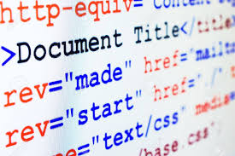
Embedded QR Codes in Web Pages
Google Chrome: Right click on the page and choose ”view page source”
http://clevelandlawlibrary.org/Public/Misc/subjects/QRCodes.html
Microsoft Edge: Right click on the page and choose “View source”
http://clevelandlawlibrary.org/Public/Misc/subjects/QRCodes.html
img= image
alt=text string (e.g., a title)
src=source (e.g., jpeg, png)

Slide 10
Caveats for Using QR Codes
Make sure to only link to content that is optimized for reading on mobile devices.
Easy to read on small screens
Content loads quickly
Leave some white space around each QR code to enable easy scanning.

Slide 11
How We Are Using QR codes
Marketing materials
Stacks for our subject collections
Subject Guides to our print/online collections

Slide 12
Marketing Materials
SHOW AND TELL

Slide 13
Stacks

Slide 14
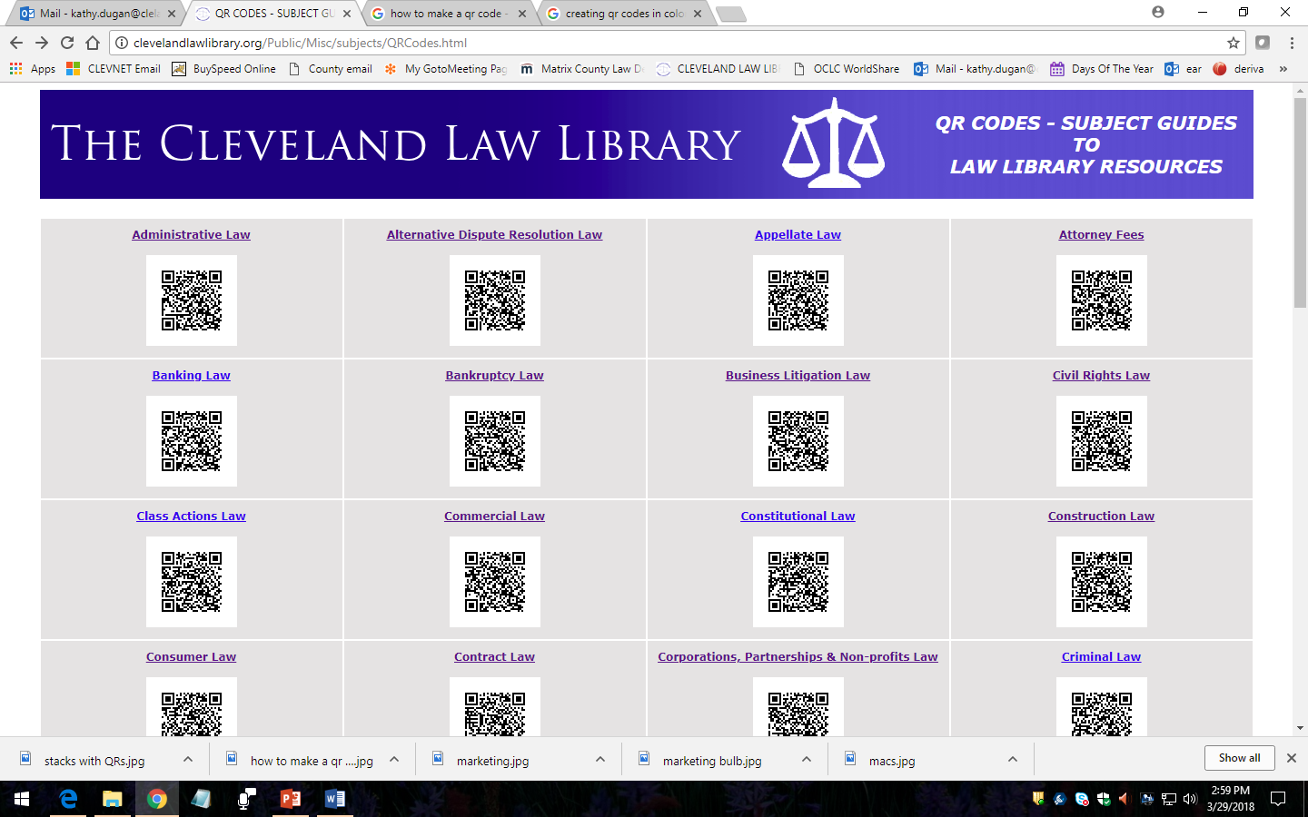
Subject Guides
http://clevelandlawlibrary.org/Public/Misc/subjects/QRCodes.html

Slide 15
How Other Law Libraries are Using QR Codes
Cornell Law Library: links to online resources; links from print items to their electronic equivalents
https://blog.law.cornell.edu/library/2011/07/14/qr-codes-hit-the-library/
University of Wisconsin School of Law: links to subject guides and online resources
https://law.wisc.edu/newsletter/Law_Library_and_IT/QR_Codes_in_the_Law_Library_Scan_2013-12-10
Florida A&M University Law Library: links to information about circulation and reference policies; on the ends of book ranges to explain what the ranges contain
http://library.famu.edu/c.php?g=276137&p=1842421

Slide 16
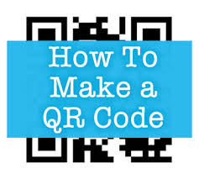
How to Create QR Codes
Use a QR code creator or generator
We use:
QR Code Generator (free):
https://www.the-qrcode-generator.com/

Slide 17
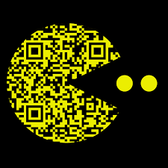
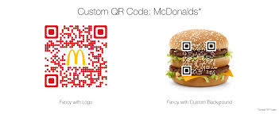
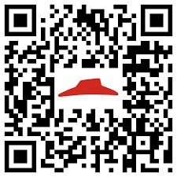
Customizing QR Codes
Customization
Select Colors
Add a Logo
Choose a shape

Slide 18
Caveat for Customizing
Some QR readers cannot read customized codes

Slide 19
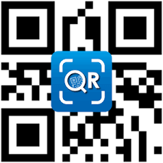
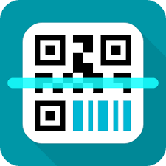
How to Read/Scan QR Codes
QR codes are read or scanned using an APP called a QR code reader or QR code scanner.
Some newer SmartPhones come equipped with pre-installed QR code readers.
We use:
Lightning QRcode Scanner (free from Application4u)
QR & Barcode Scaner (free from TeaCapps)
There are a lot of free readers/scanners available:
http://www.708media.com/qrcode/qr-code-readers-iphone-android-blackberry-windows-phone-7/

Slide 20
Presentation Is Available Online
To view this presentation online, download a QR reader and scan the QR code on your postcard.

Slide 21
Questions?
Contact Information:
Kathy Dugan
Cleveland Law Library
Kathy.dugan@clelaw.lib.oh.us

