Slide 2
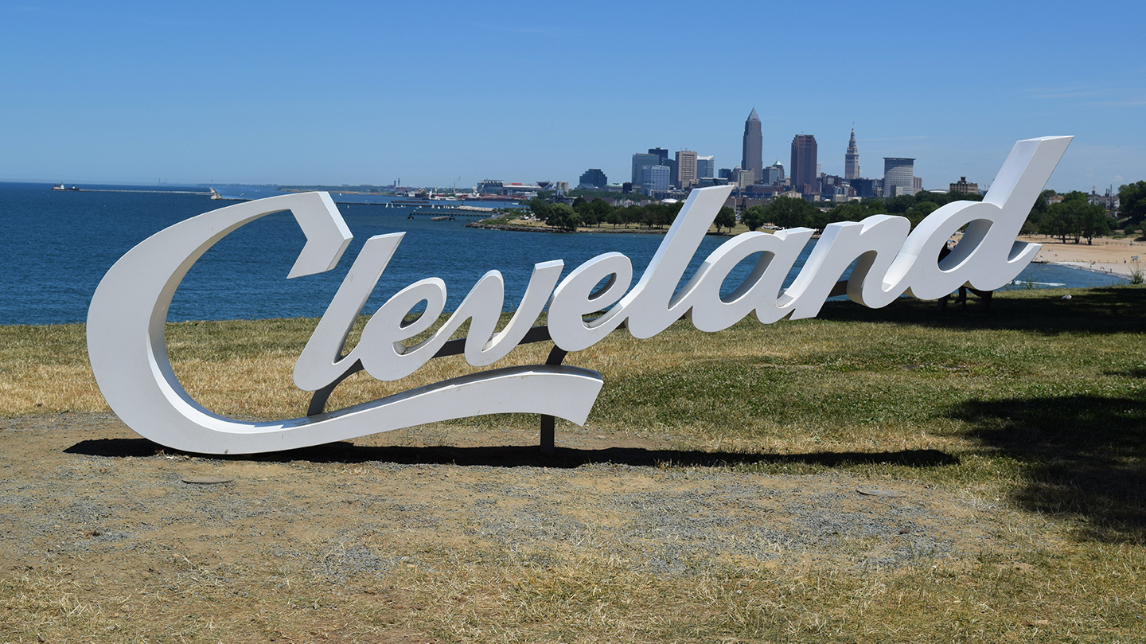

Slide 3
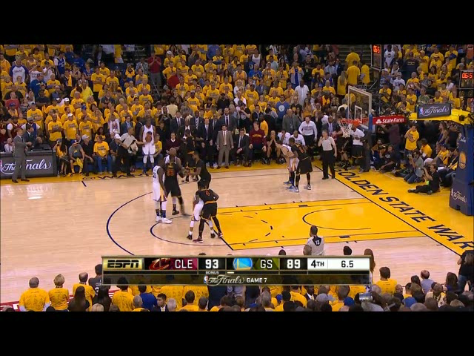

Slide 4



Slide 5
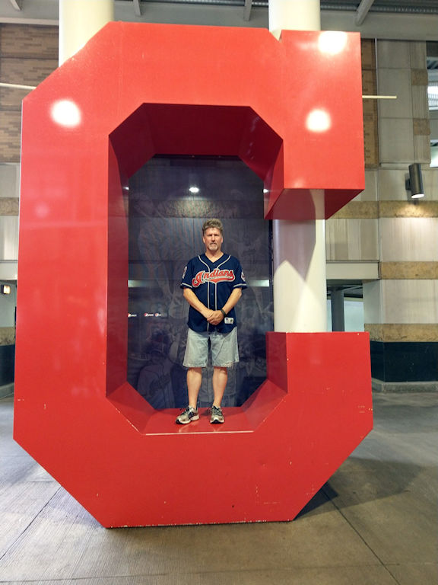

Slide 6
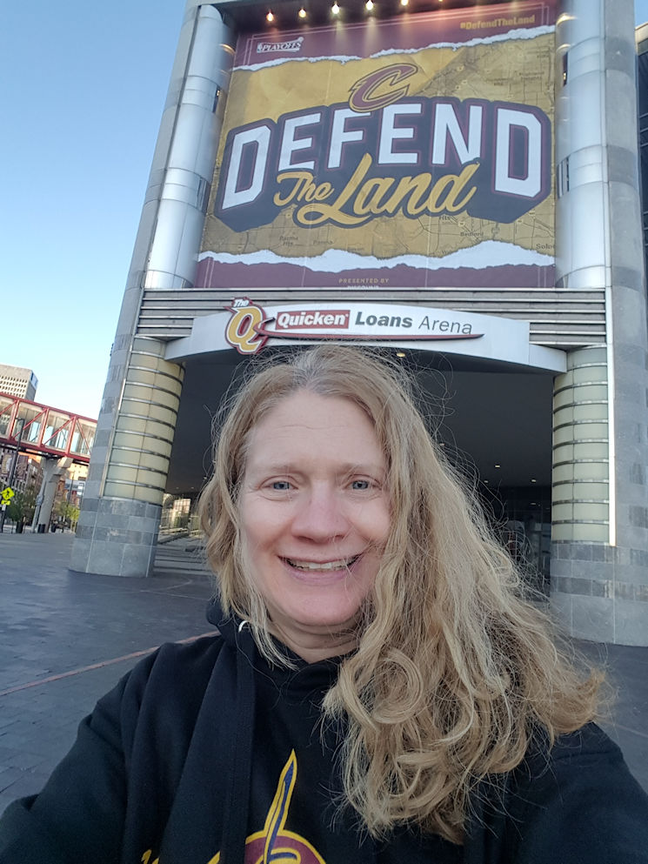

Slide 7
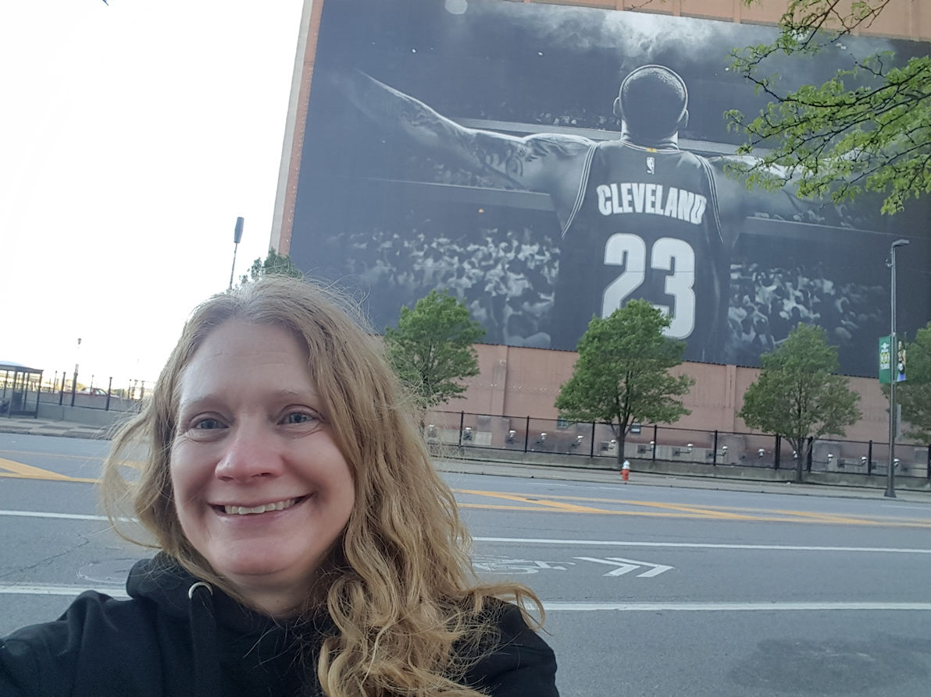

Slide 8
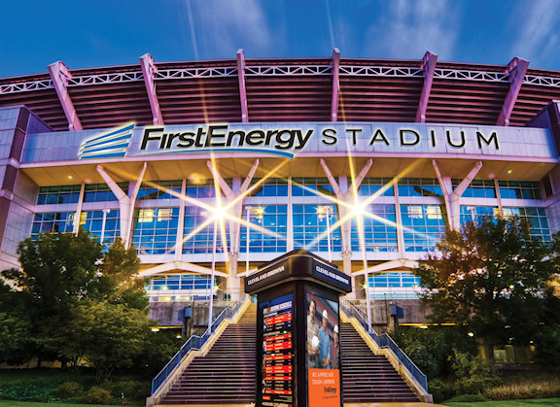

Slide 9


Slide 10
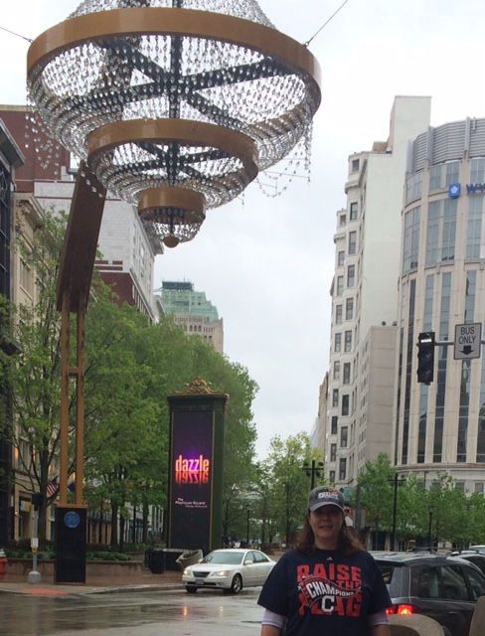

Slide 11
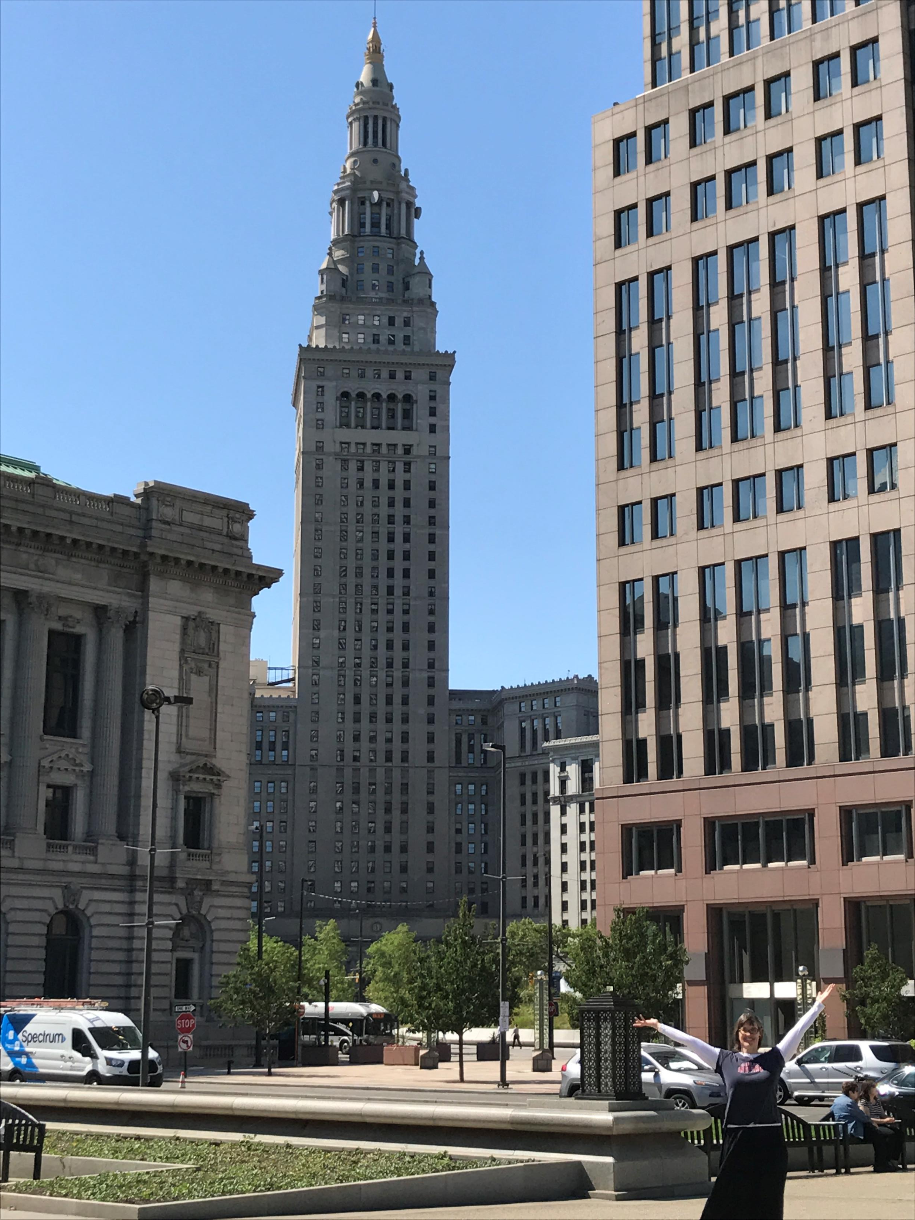

Slide 12
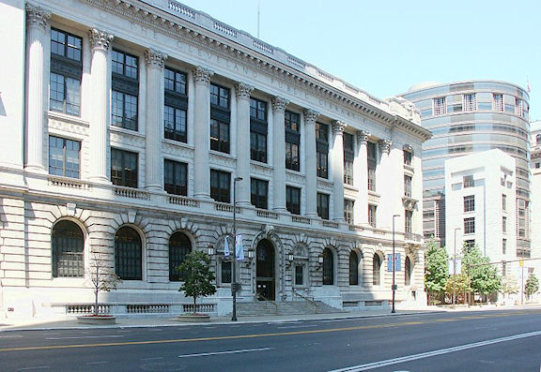

Slide 13
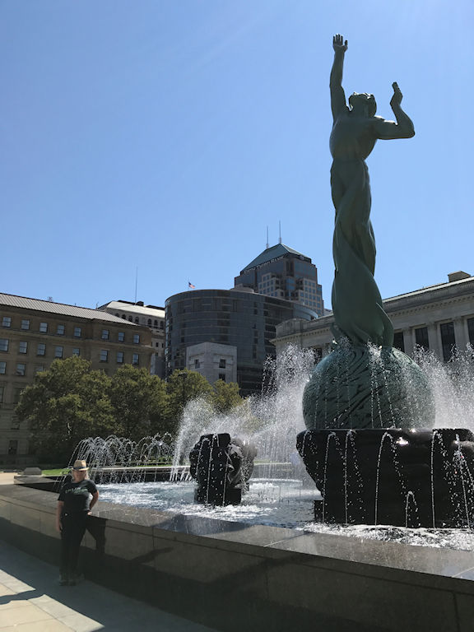

Slide 14
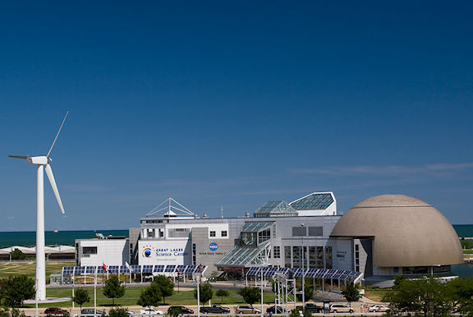

Slide 15
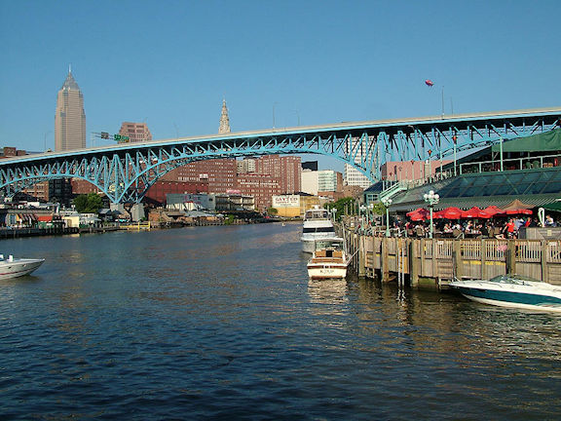

Slide 16
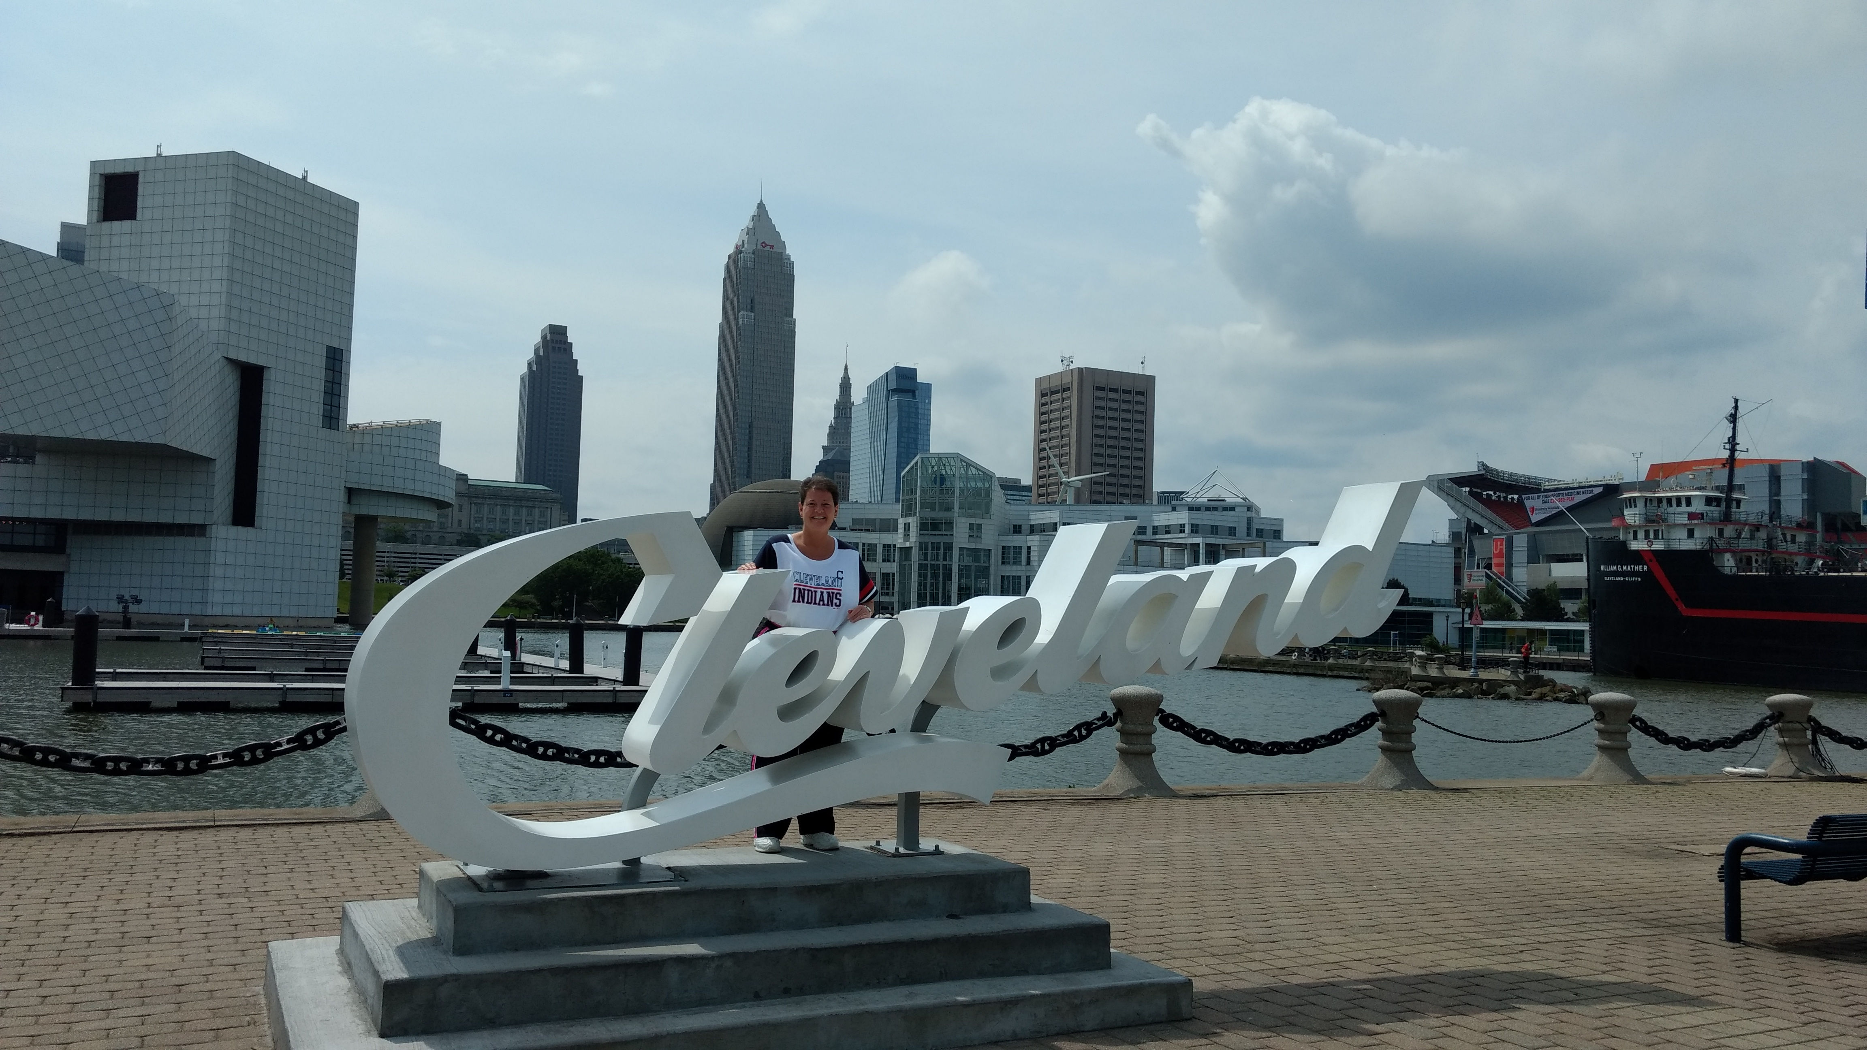

Slide 17
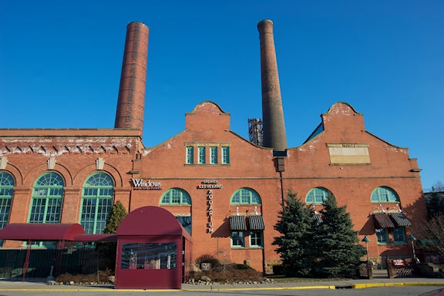

Slide 18


Slide 19
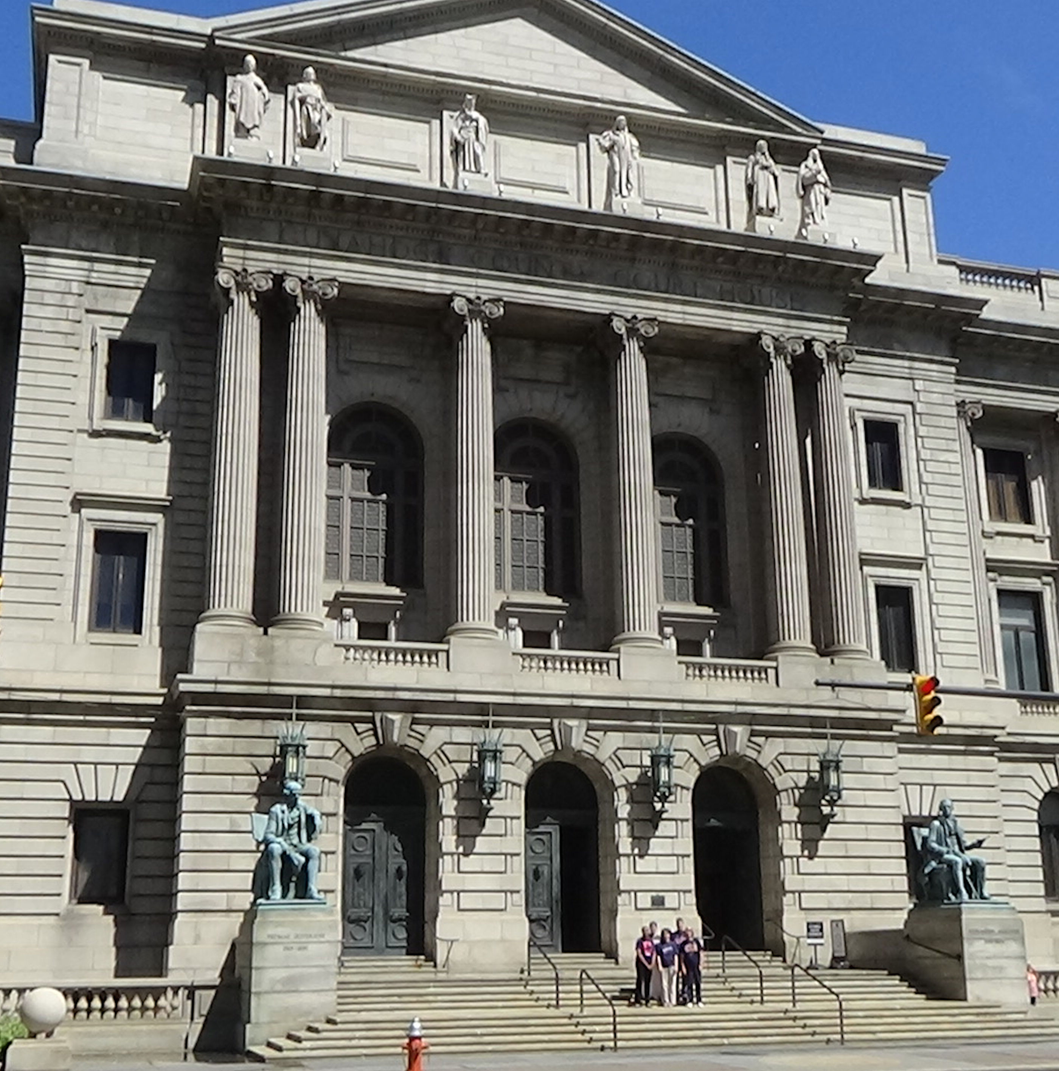

Slide 20
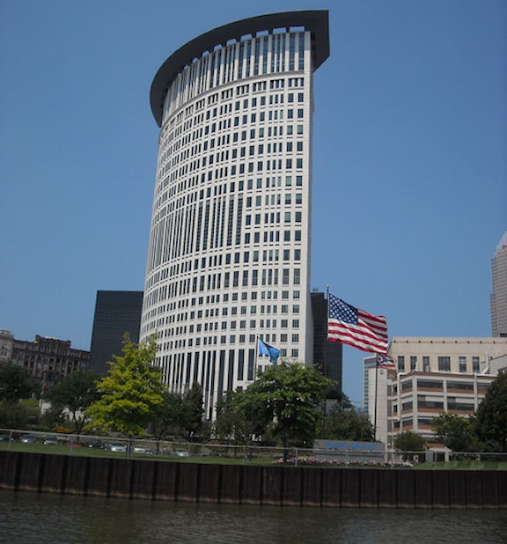

Slide 21


Slide 22
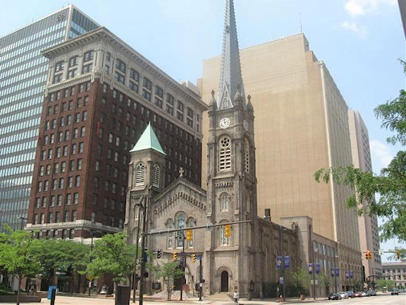

Slide 23


Slide 24
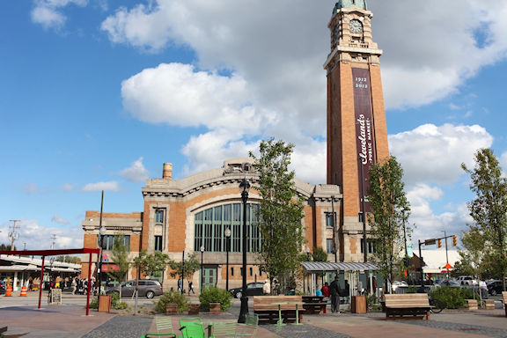

Slide 25


Slide 26


Slide 27
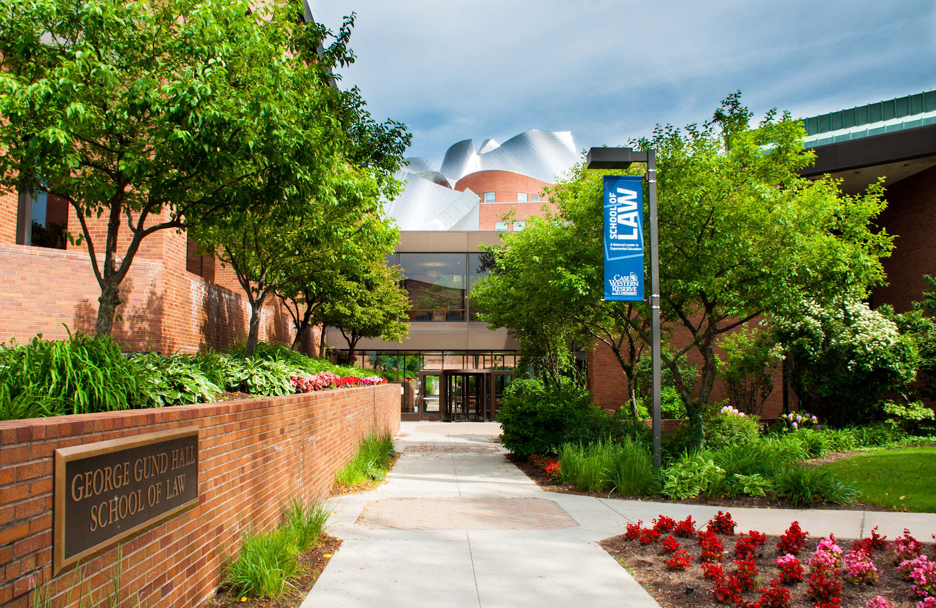

Slide 28


Slide 29


Slide 30
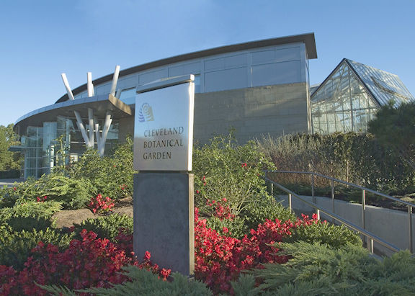

Slide 31
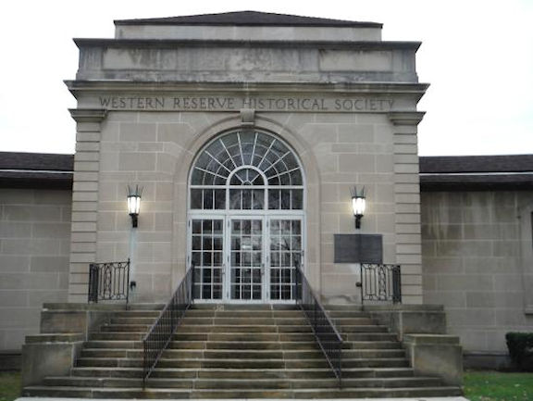

Slide 32


Slide 33
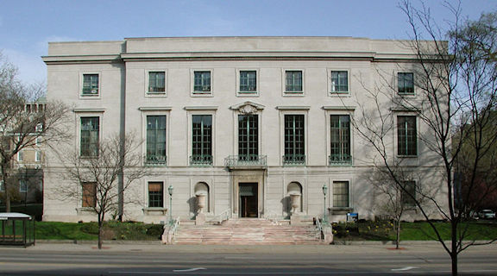

Slide 34

Thank You For Coming
And Enjoy Your Stay In

Slide 35
The Ohio Regional Association of Law Libraries
gratefully acknowledges generous contributions from
the following organizations and individuals:
Case Western Reserve Law Library
ProQuest
Commonwealth Law Books
Ohio Capitol Connection
Fastcase, Inc.
Gale
LexisNexis
Thomson Reuters
HeinOnline
Bloomberg Law
PLI
Cleveland Metropolitan Bar Association
Thank you for your support!

Slide 36


Slide 37


